Slide 1
ICRISAT-DISTRICT LEVEL DATA
SUBMITTED BY
MEGHA BISHT
DATA ANALYST INTERN

Slide 2
INTRODUCTION
This project aims to do comprehensive analysis of Indian agriculture, focusing on district-wise and year-wise data.
The dataset provides detailed information on various crops, there areas, production, and yields across different districts and years.
The goal is to use Power BI to create interactive visualizations that uncover trends, patterns in agricultural practices, enabling stakeholders to make informed decisions for sustainable farming and resource allocation.

Slide 3
DASHBOARD OVERVIEW
Provided different data visualizations such as:-
Sum of diff crop area by year.
Sum of different crop production by year.
Sum of different crop production by state name.
Sum of different crop production by district name.
Sum of different crop area by state name.
Sum of different crop area by district name.
Added slicers for district name and Year.

Slide 4
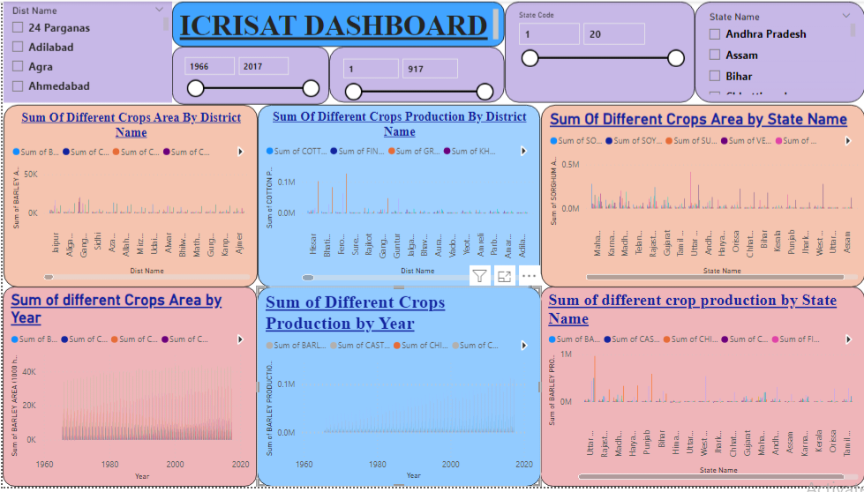
DASHBOARD

Slide 5
KEY FINDINGS
Various key findings I had analyzed :-
Wheat Production is maximum in year 2016.
Rice Production is maximum in West Bengal.
Midanpur has maximum crop production and then followed by Karnal.
Uttar Pradesh has maximum crop area.
Midanpur has maximum crop area followed by Berma.

Slide 6
THANK YOU

